Slide 1


Exam DP-420: Microsoft Cosmos DB Developer Crash Course
Tim Warner

Slide 2

Tim Warner
Based in Nashville, TN, US
Central time zone
Senior Content Developer, Microsoft
MCT, former MVP
Twitter: @TechTrainerTim

Slide 3
Day 1 of 2 Agenda
Introduction
Design and implement data models (35–40%)
Design and implement data distribution (5–10%)

Slide 4
Day 2 of 2 Agenda
Content catch-up
Integrate an Azure Cosmos DB solution (5–10%)
Optimize an Azure Cosmos DB solution (15–20%)
Maintain an Azure Cosmos DB solution (25–30%)

Slide 5
Course Materials
timw.info/dp420

Slide 6
Course Expectations
Please review the recordings…several times!
10-minute break at midpoint
I’m here to answer your questions – take advantage of this
Use the Q&A panel

Slide 7

Session Recordings

Slide 8

Session Recordings

Slide 9

Session Recordings

Slide 10


Mobile Browser: learning.oreilly.com

Slide 11



O'Reilly Mobile App

Slide 12
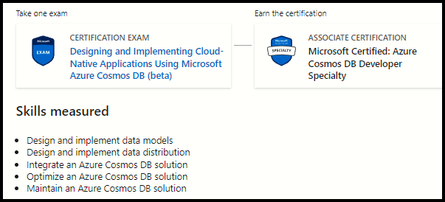
Azure Cosmos DB Developer
DP-420

Slide 13
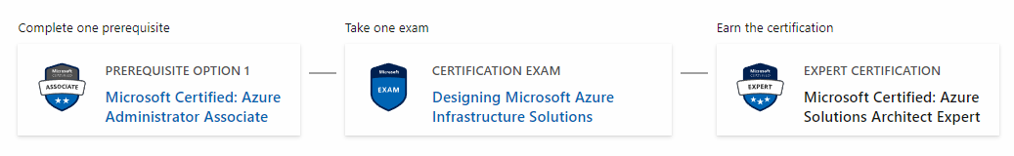
Related Certifications
AZ-104
AZ-305

Slide 14
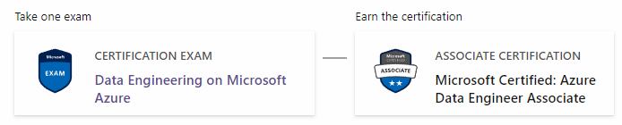
Related Certifications
DP-203

Slide 15
DP-420: “Need to Know” Info
Core (SQL) API is only API covered
SDK code: C# with perhaps a sprinkling of JavaScript
DevOps:
Azure PowerShell
Azure CLI
Kusto

Slide 16

Tim's Certification Study Model

Slide 17
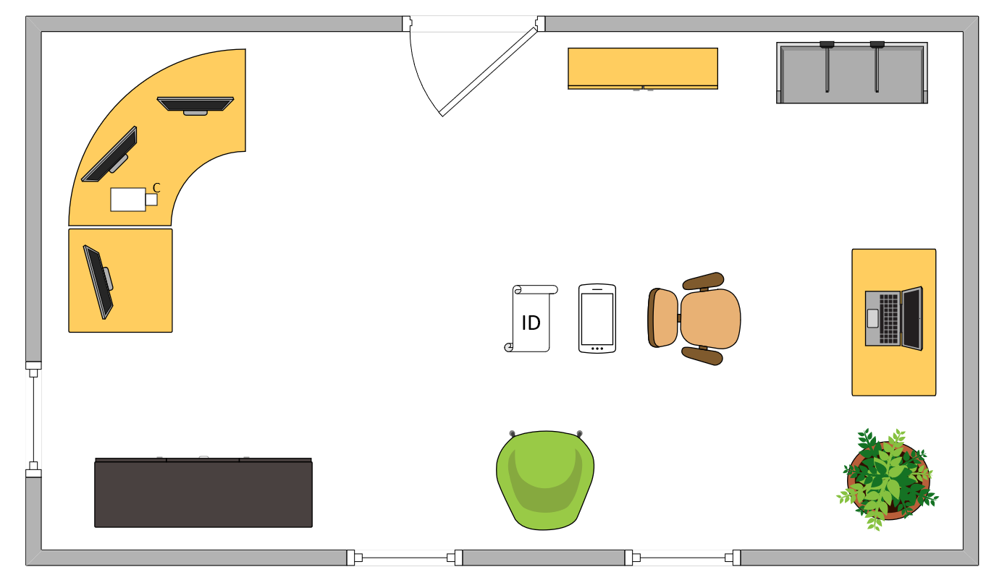
Tim’s Ideal Testing Room

Slide 18
Thank you!
Course materials: timw.info/dp420
Twitter: @TechTrainerTim
Pluralsight: timw.info/ps
Web: timw.info

Slide 19
Data Modeling

Slide 20

Cosmo DB APIs
Core (SQL) API
JSON documents
SQL-like query language
MongoDB API
BSON documents
Use existing Mongo apps by changing connection string
Table API
Key-value data
Expands capability of Azure Table storage

Slide 21
Cosmo DB APIs
Apache Cassandra API
Column-oriented schema
Interact with data using Cassandra Query Language (CQL)
Apache Gremlin API
Graph-schema (edges and vertices)
Supports Apache TinkerPop graph traversal language

Slide 22
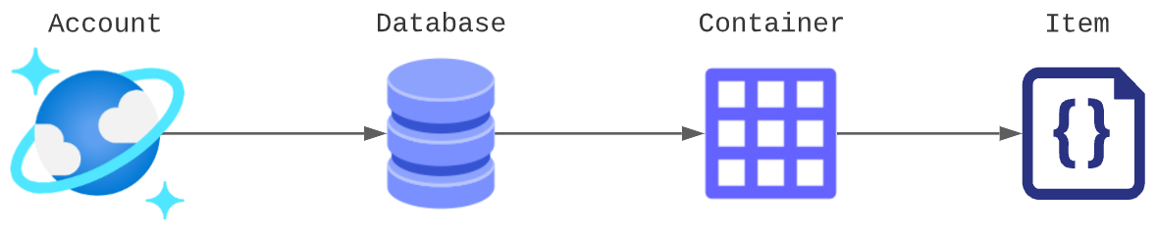
Cosmos DB Core API Object Model
2 MB

Slide 23

Measuring Cosmos DB Performance
Latency
Wait time
Deploy read-only or write replicas geographically
Requests
Compute (CPU, memory, network, storage)
Number of requests per second
Request Unit (RU) – deterministic measure

Slide 24
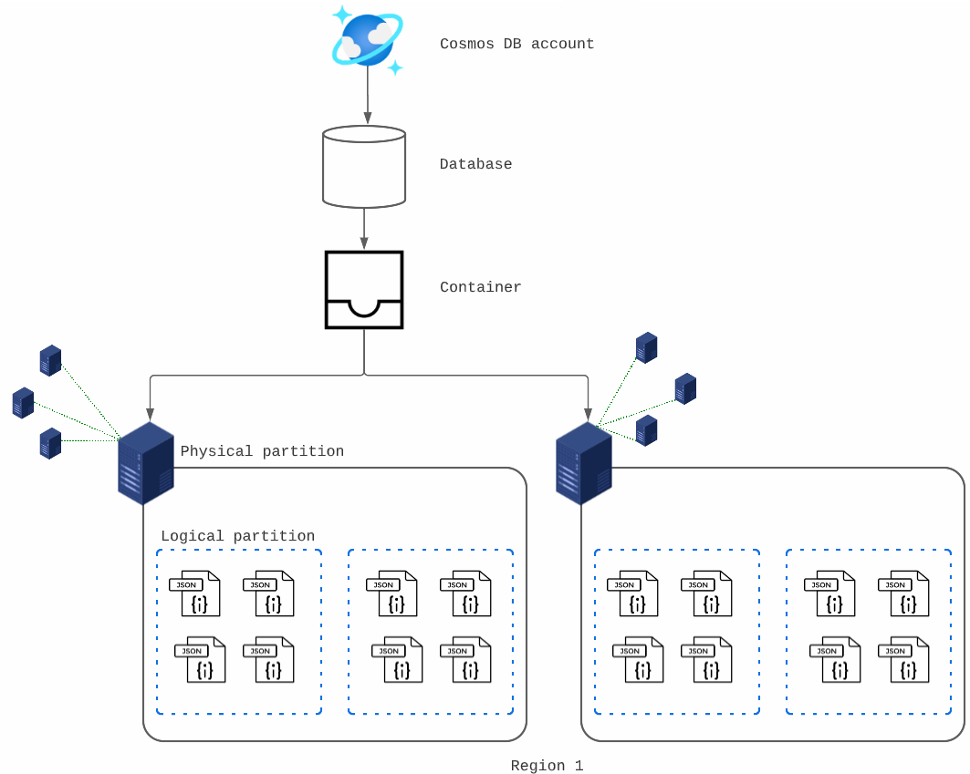
Cosmos DB Storage Architecture
50 per subscription
500 per account
Unlimited storage
25 per database
10,000 RUs
Replica set
2 MB

Slide 25
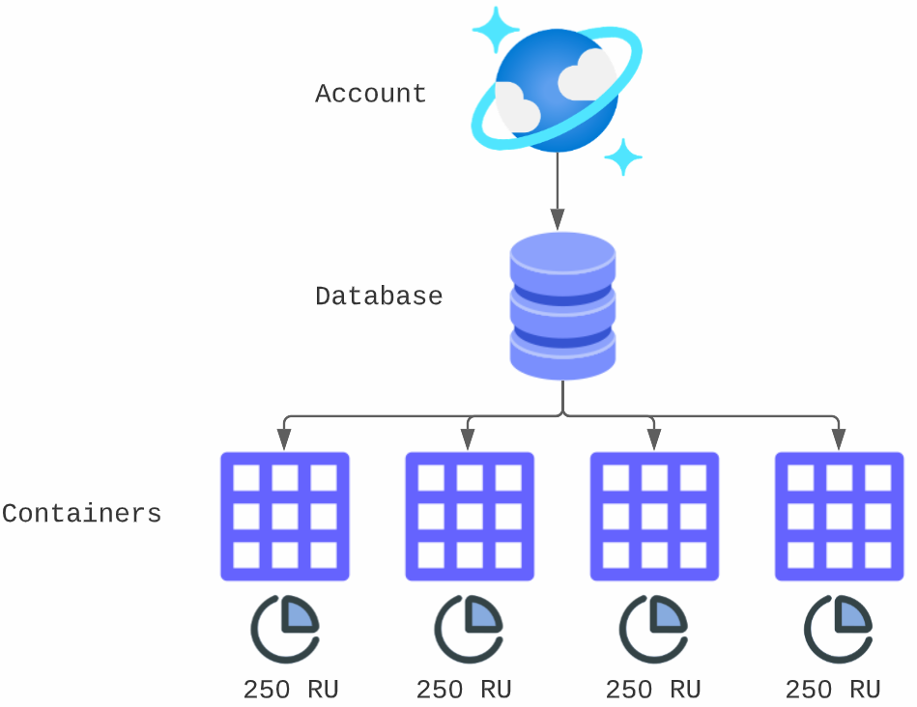
Container-Level RU Provisioning

Slide 26
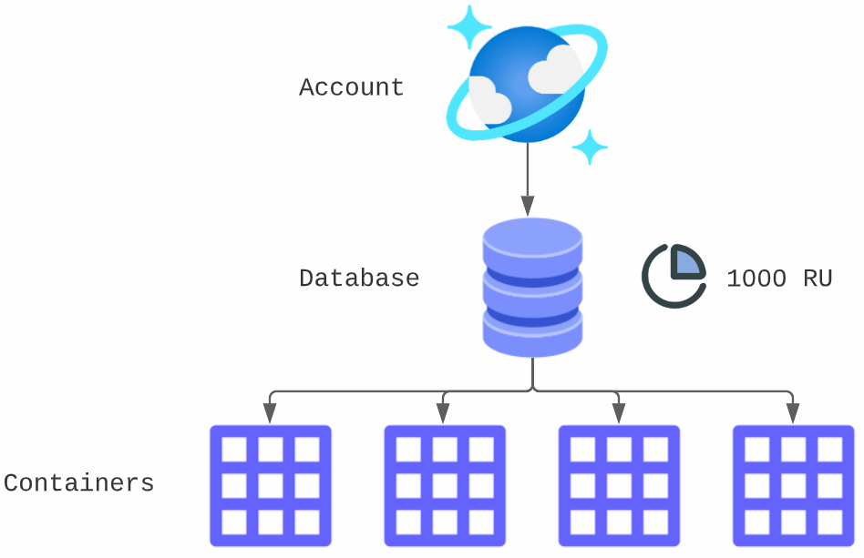
Database-Level RU Provisioning

Slide 27

Cosmos DB Data Modeling
Schema-free databases store unstructured and semi-structured data
Build data model to maximize performance and scalability and to minimize cost
Questions:
How is NoSQL data modeling different from relational data modeling?
Should I embed or link data in my JSON documents?

Slide 28
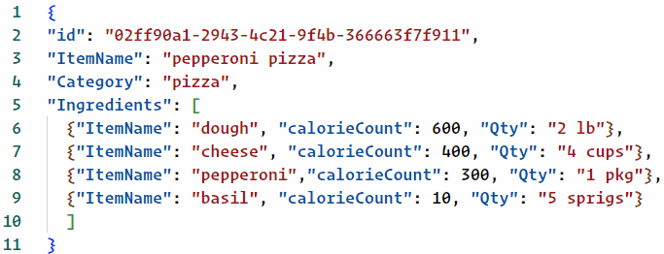
Data Denormalization
Denormalizing gives better read performance
Ingredients are always queried with the item
Good for relations that won't grow without bound and that don't change frequently

Slide 29
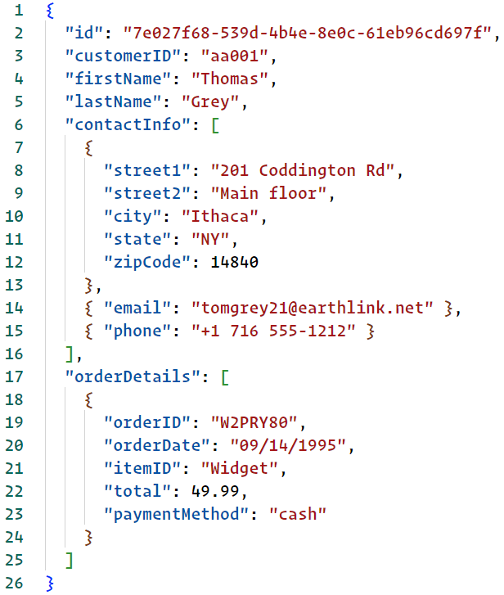
Data Denormalization
In this case querying for Customer ID aa001 gives us all related customer information
What if Tom orders a LOT of product?

Slide 30

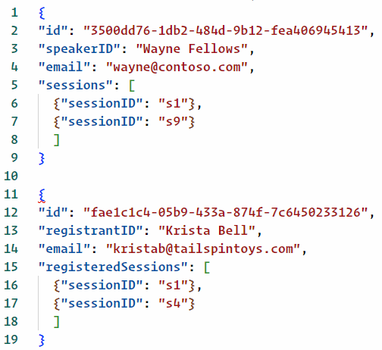
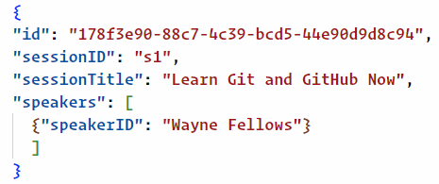
Data Normalization

Slide 31

Data Normalization
Typically data normalization (linking) provides better write performance
Normalized data models can require more round trips to the server to resolve references (read penalty)
Remember that Cosmos DB indexes all your data automatically
In general, use normalized data models with:
One-to-many unbounded relationships
Regularly changing data

Slide 32
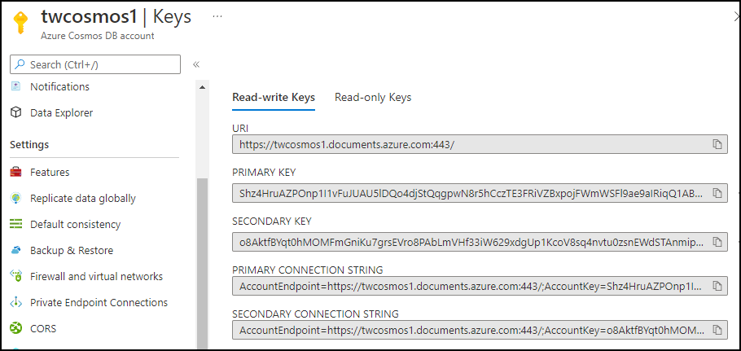
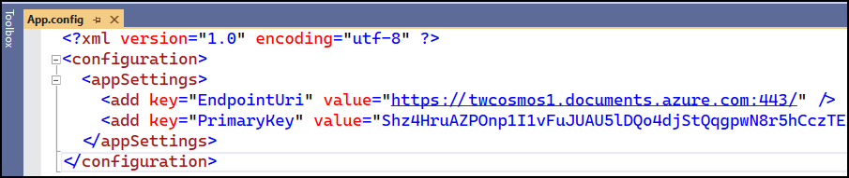
Primary and Secondary Keys

Slide 33

Partition Keys
Key:value that determines how Cosmos partitions (shards) the documents across partitions
Each partition key = logical partition
Cannot change once set during container creation
Goal is to spread RU consumption and storage equally
You can use the item ID as partition key

Slide 34
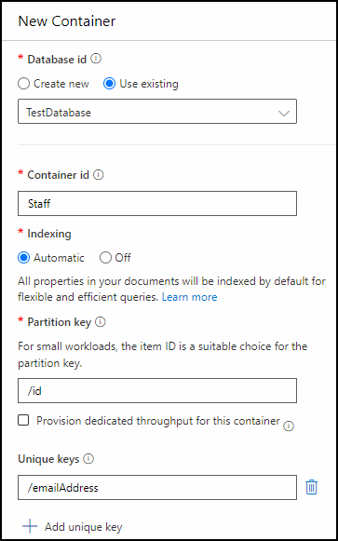
Unique Key Constraints
Constraint that prevents duplicate values within a logical partition
Example: Prevent duplicate email addresses for docs with the same CompanyID partition key
Can define only during container creation

Slide 35
Cosmos DB SQL SDK Connectivity Modes
Gateway Mode
Direct Mode
Supported on all SDKs
Uses HTTPS at single DNS endpoint
Gateway "fans out" client requests to back-end nodes
Recommended when applications have few ports available (corporate firewalls)
Supported on .NET and Java SDKs
TCP with TLS single-port connections that bypass gateway
Better performance than Gateway mode
Client needs wide access to API and service ports

Slide 36
Cosmos DB SQL Data Access
CRUDQS
Create, Delete: Management plane operations
Query with SQL-like data access language
Update is actually a Replace operation (partial document update Patch API is available)
S = Server-side JavaScript scripts
Stored procedures
Triggers
User-defined functions

Slide 37

Cosmos DB Access Options
Three scopes:
Account
Database
Container
Two planes:
Management
Data
Methods:
Master key
Resource tokens
Azure AD RBAC

Slide 38
Cosmos DB Resource Tokens
Local Cosmos DB users
Time-limited (1-5 hours) access to containers, partition keys, documents, server-side JavaScript
Cosmos DB doesn't implement the authentication
Integration with Azure AD can be challenging

Slide 39
Cosmos DB Role-Based Access Control
Built-in control plane RBAC roles:
DocumentDB Account Contributor: Manage accounts
Cosmos DB Account Reader Role: Read account data
CosmosBackupOperator & CosmosRestoreOperator
Cosmos DB Operator: Provision accounts, databases, and containers
Custom roles are supported

Slide 40
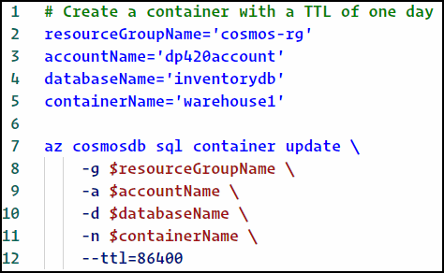

Cosmos DB Time to Live (TTL)
Property defined at the container level that instructs Cosmos DB to delete documents after a configured time period
Default value is no expiration
Manually specify with -1

Slide 41

Cosmos DB Partition Strategy
Goals:
Choose partition key that distributes requests and storage equally
Aim for 80/20 percent queries to single partition vs cross-partition
Questions:
What are my workload's access patterns?
Reads vs writes
What are my scaling needs?
Vertical (RUs) and horizontal (replication)

Slide 42

Choosing a Partition Key
Needs to exist in every document in the container
High cardinality
String or numeric value
Can be built-in /id property

Slide 43
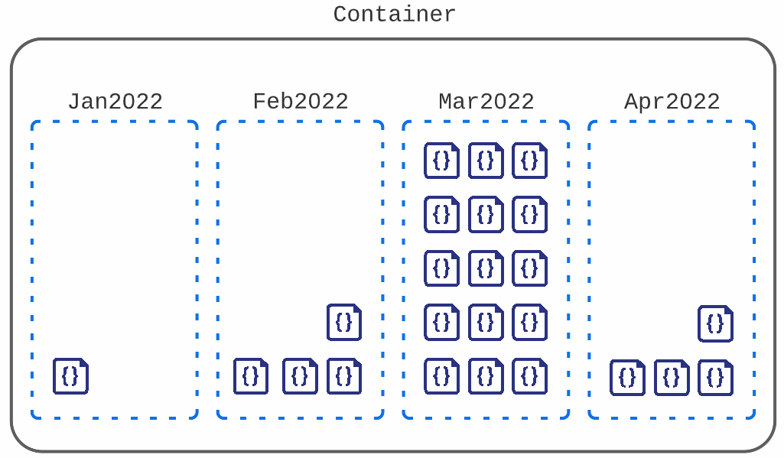
"Hot" Partitions
/orderDate as partition key

Slide 44
Cosmos DB Throughput Models
Provisioned
Serverless
Pre-provisioned compute
Good for workloads with sustained traffic
Per-hour billing for number of RUs provisioned
No pre-provisioned compute
Good for workloads with intermittent or unpredictable traffic
Per-hour billing on consumed RUs
Needs to be specified at account creation time

Slide 45
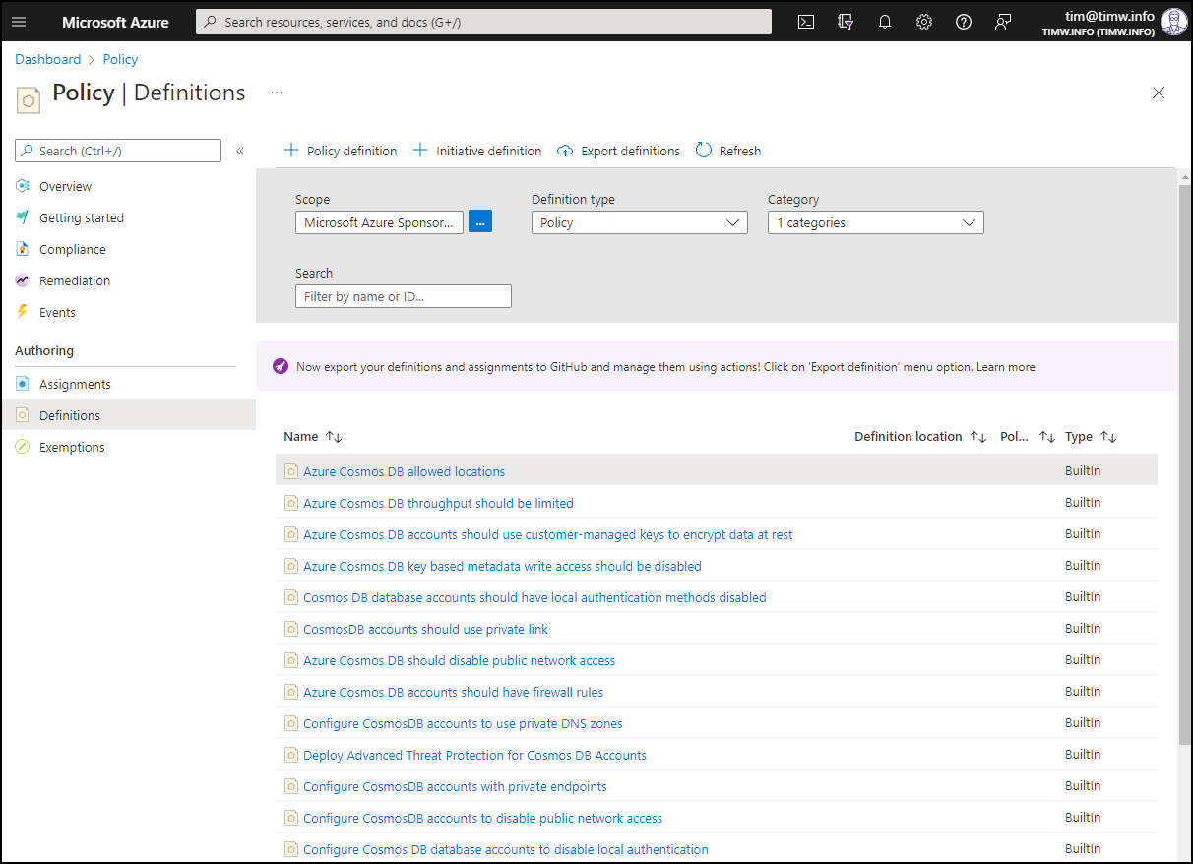
Azure Policy

Slide 46
Cosmos DB Global Replication
Provides low latency and high availability for your account
Unlimited elastic read and write scalability with 99.999% rw availability
Service-managed failover to cover regional outages
Five programmable consistency levels
Throughput, storage, gateway costs are billed across every region used (not per-region)

Slide 47
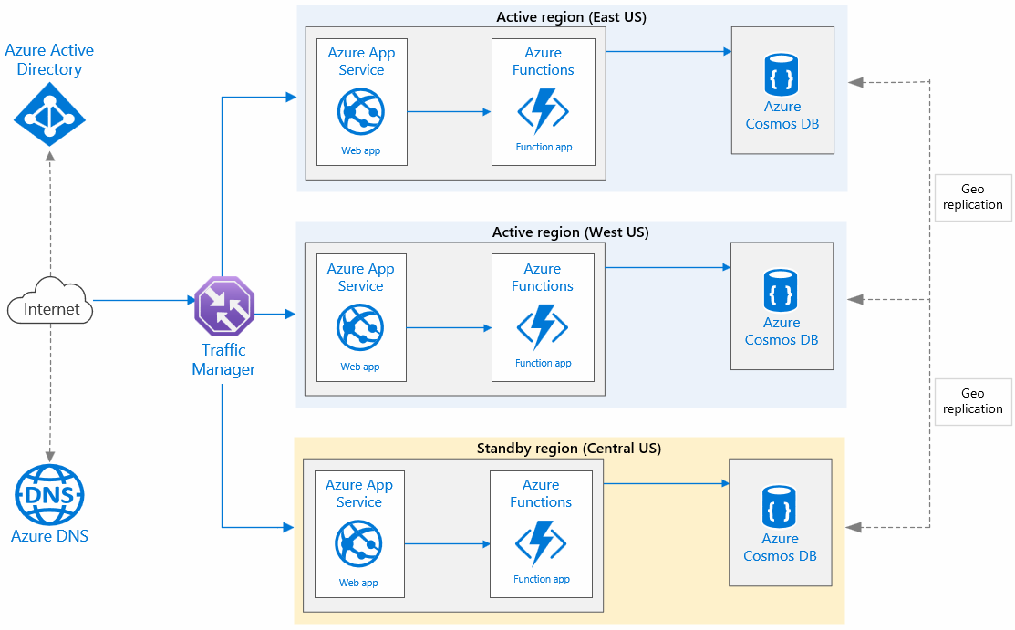

Globally Distributed Web App
Multi-region writes

Slide 48
Consistency Levels
Relational model: ACID
Atomicity, Consistency, Isolation, Durability
Non-relational model: CAP
Consistency, Availability, Partition tolerance
Normally only 2 of 3 elements guaranteed
Trade-off between consistency and availability
User A adds a document to East US container
What will User B see when they query the container from Australia?

Slide 49
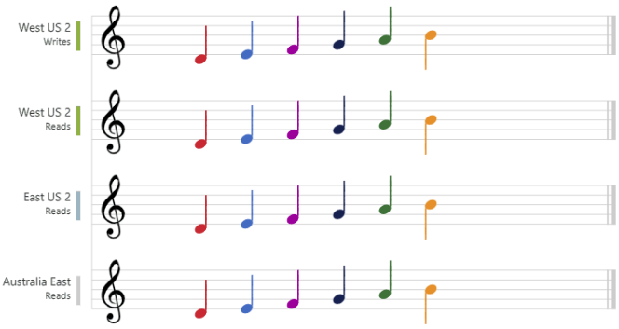
Strong
Users are guaranteed to see the latest committed write
Suitable for use cases that forbid data loss (for instance, banking transactions)
Highest consistency
Highest latency
Lowest availability

Slide 50
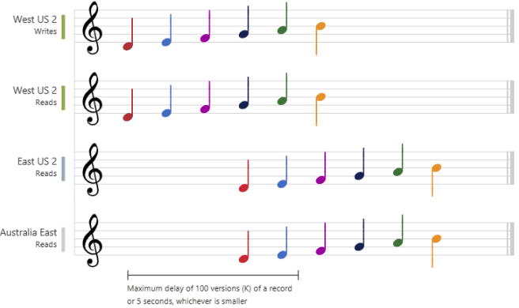
Bounded Staleness
Intended for global apps that expect low write latencies with total global order guarantees
Specify maximum tolerable lag for operations and time
Examples: Stock ticker, group collaboration, message queueing

Slide 51
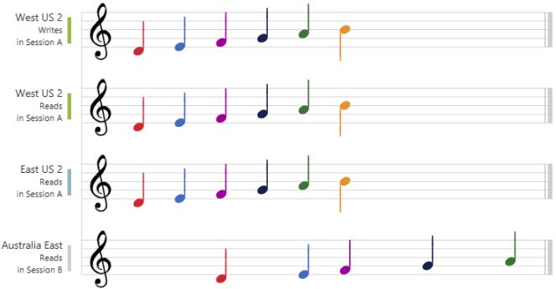
Session
Default consistency level
Good performance and availability
User sees their own updates immediately within their session

Slide 52
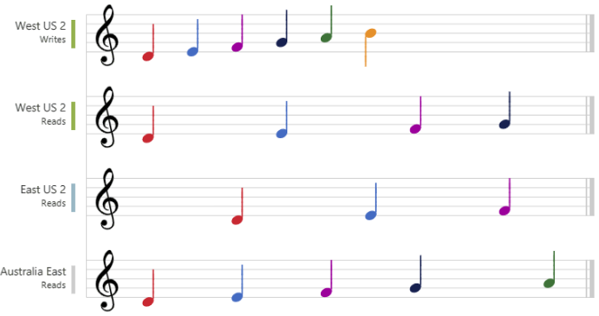
Consistent Prefix
Like bounded staleness, but without operational/time lag guarantee
Does guarantee order (high read consistency)
Good performance
High availability

Slide 53
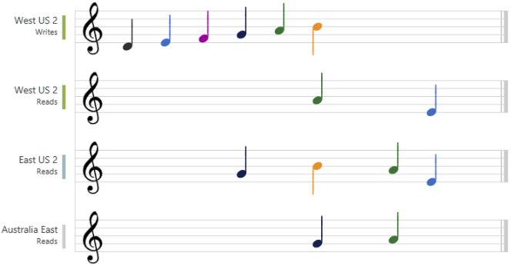
Eventual
Weak consistency with no ordering guarantee
Lowest latency
Highest throughput
Use case: like count for social media apps, comments

Slide 54
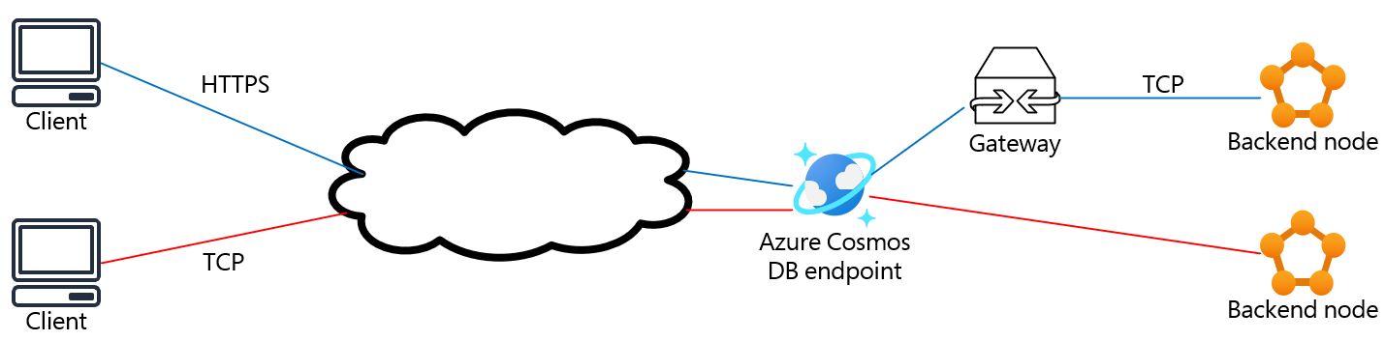
Cosmos DB Connection Modes
Gateway mode
Direct mode

Slide 55
Create a Cosmos DB Connection Modes
CosmosClientOptions clientOptions = new CosmosClientOptions()
{
ConnectionMode = ConnectionMode.Gateway,
ApplicationRegion = "EastUS",
ConsistencyLevel = ConsistencyLevel.Eventual
};
string endpoint = "https://tw.documents.azure.com:443/";
string key = "eC1dd8QgjekvERMZ==";
CosmosClient client = new (endpoint, key);

Slide 56
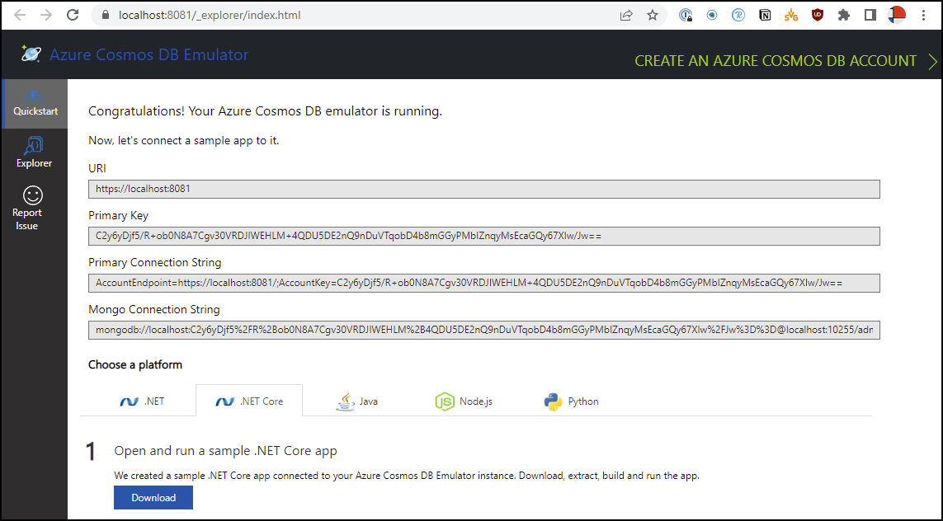

Cosmos DB Emulator

Slide 57
Cosmos DB Connection Errors
Cosmos DB .NET SDK handles transient errors to retry read and query requests
Does not automatically retry write requests
Relevant retry-related server-side HTTP status codes:
429: Too many requests
449: Concurrency error
500: Unexpected service error
503: Service unavailable

Slide 58
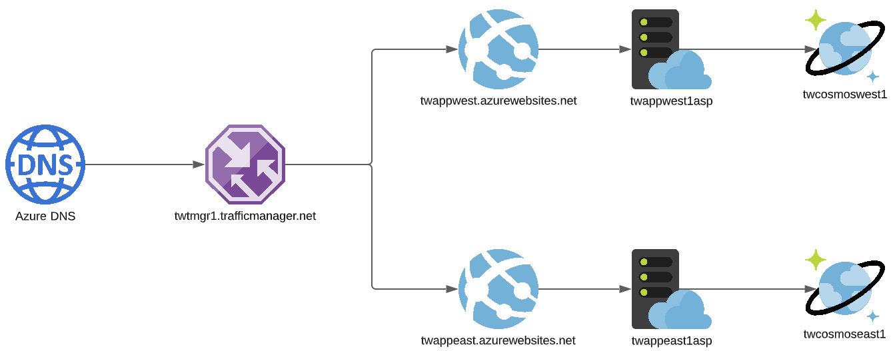
Cosmos DB Global Distribution

Slide 59
Cosmos DB Conflict Resolution
Container container = await createClient.GetDatabase(this.databaseName)
.CreateContainerIfNotExistsAsync(new ContainerProperties(this.lwwCollectionName, "/partitionKey")
{
ConflictResolutionPolicy = new ConflictResolutionPolicy()
{
Mode = ConflictResolutionMode.LastWriterWins,
ResolutionPath = "/myCustomId", // timestamp is default
}
});

Slide 60
Configure Request Options
QueryRequestOptions options = new ()
{
MaxItemCount = 500, // -1 for dynamic page size
MaxConcurrency = 5, // //-1 to let SDK manage
MaxBufferedItemCount = 5000 // -1 to let SDK manage
};

Slide 61
Cosmos DB SQL Query Language
Familiar search syntax to query semi-structured JSON data
SELECT statement; FROM keyword (container)
Queries cost at least 2.3 RUs
Point read: Lookup on item ID and partition key
SELECT * from c
SELECT c.id, c.name, c.price,FROM c
SELECT c.id, c.name, c.price,FROM c
WHERE c.price >= 49.99 AND c.price <= 99.99

Slide 62
Cosmos DB SQL Query Interfaces
Server-side
SQL, JavaScript integrated query
Client-side
.NET (LINQ), Java, JavaScript, Node.js, Python, REST API

Slide 63
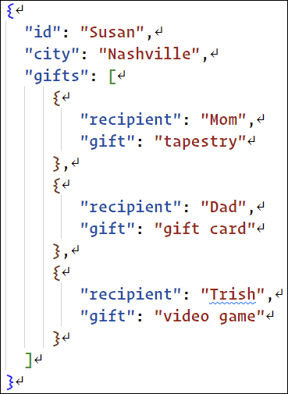
Accessing Arrays
// get Dad's gift
SELECT * FROM c WHERE c.gifts[0].recipient = "Dad"
// Show all gifts (g is arbitrary)
SELECT * FROM C IN g.gifts
// Filter for city (outside array)
SELECT c.id, t AS gifts FROM c
JOIN t IN c.gifts
WHERE t.recipient = "Mom" AND c.city = "Nashville"

Slide 64
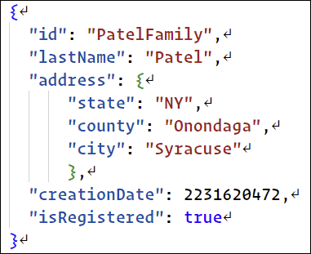
Accessing Nested JSON Properties
// Project two nested properties
SELECT f.address.state, f.address.city
FROM Families f
WHERE f.id = "PatelFamily"

Slide 65
Aggregate Functions
// get total item count in a container
SELECT COUNT(1) FROM c
// get average value of propertyA
SELECT AVG(c.propertyA) FROM c
// get sum of propertyA
SELECT SUM(c.propertyA) FROM c

Slide 66
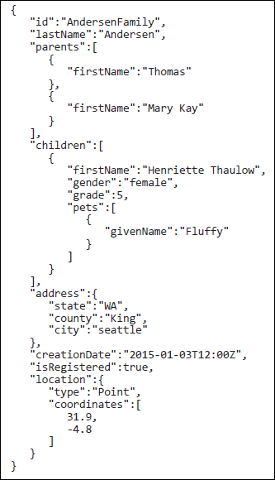
Ordering
SELECT f.id, f.address.city
FROM Families f
ORDER BY f.address.city
SELECT *
FROM Families
WHERE Families.address.state IN
("NY", "WA", "CA", "PA", "OH",
"OR", "MI", "WI")
ORDER BY Families.address.state DESC

Slide 67
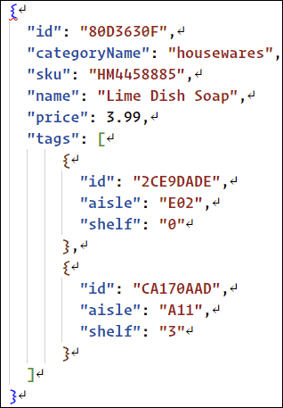
Correlated Subquery
// Subquery is query within a query
// Correlated means inner query
// references outer query
// filter out shelf 3
SELECT p.id, p.name, t.name AS tag FROM products p
JOIN (SELECT VALUE t FROM t IN p.tags
WHERE t.shelf = '3') AS t

Slide 68
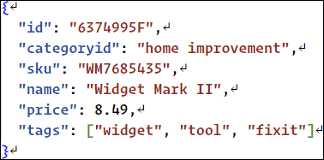
Type-Checking Functions
// does the tags property exist?
SELECT IS_DEFINED (c.tags) AS tags_exist FROM c
// is the tags property an array?
SELECT IS_ARRAY (c.tags) AS tags_is_array FROM C
//is the tags property null?
SELECT IS_NULL (c.tags) AS tags_is_null FROM c
// IS_NUMBER; IS_STRING, IS_BOOLEAN

Slide 69
Mathematical Functions
// rounds positive and negative numbers to nearest integer
SELECT ROUND(2.4) AS r1, ROUND(2.6) AS r2, ROUND(2.5) AS r3, ROUND(-2.4) AS r4, ROUND(-2.6) AS r5
// return square roots of numbers 1-3
SELECT SQRT(1) AS s1, SQRT(2.0) AS s2, SQRT(3) AS s3
// returns largest integer <= the specific number
SELECT FLOOR(123.45) AS fl1, FLOOR(-123.45) AS fl2, FLOOR(0.0) AS fl3
// results: [{fl1: 123, fl2: -124, fl3: 0}]

Slide 70
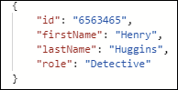
String Manipulation Functions
// string concatenation
SELECT CONCAT(c.firstname, ' ', c.lastname) AS fullName FROM c
// force casing (no obj returned)
SELECT VALUE LOWER (c.productName) FROM c
// Dept code between 0 and 99
SELECT * FROM c WHERE RegexMatch (c.deptCode, "[0-99]","")
// CONTAINS, ENDSWITH, STARTSWITH,
// LTRIM, RTRIM, SUBSTRING, UPPER

Slide 71
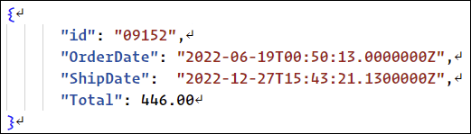
Date and Time Functions
/* UTC date and time ISO 8601 string value in the format: yyyy-MM-ddTHH:mm:ss.fffffffZ. */
SELECT GetCurrentDateTime() AS currentUtcDateTime
SELECT DateTimeAdd("mm", 1, "2020-07-09T23:20:13.4575530Z") AS OneMonthLater

Slide 72
Parameterized Queries
// protect against SQL injection
private static async Task QueryWithSqlParameters(Container container)
{
QueryDefinition query = new QueryDefinition("SELECT * FROM Families f WHERE f.id = @id AND f.Address.City = @city")
.WithParameter("@id", "AndersonFamily")
.WithParameter("@city", "Seattle");
List<Family> results = new List<Family>();
using (FeedIterator<Family> resultSetIterator = container.GetItemQueryIterator<Family>(
query,
requestOptions: new QueryRequestOptions()
{
PartitionKey = new PartitionKey("Anderson")
}))
}

Slide 73
Transactions
Batched actions that must succeed or fail 100 percent
Guarantees:
Atomicity: Commit or roll back
Consistency: Data is healthy internal state
Isolation: No two transactions interfere
Durability: Persistent changes

Slide 74
Cosmos DB Stored Procedures
JavaScript functions scoped to a single logical partition
Bounded execution: Must complete within 5 seconds
JavaScript language integrated query API
Programmatically build queries without SQL

Slide 75
Stored Procedure Example
function createDoc(title) {
var context = getContext();
var container = context.getCollection();
var doc = {
name: title,
categoryId: 'demo'
}
var accepted = container.createDocument(
container.getSelfLink(),
doc,
(error, newDoc) => {
if (error) throw new Error(error.message);
context.getResponse().setBody(newDoc);
}
);
if (!accepted) return;
}

Slide 76
Cosmos DB Triggers
Code executed automatically when an operation occurs on a Cosmos DB item
Types:
Pre-trigger: Runs before item is created
Post-trigger: Runs after operation has completed

Slide 77
Cosmos DB Pre-Trigger Example
// check for label property & add if it doesn't exist
function addLabel(item) {
var context = getContext();
var request = context.getRequest();
var pendingItem = request.getBody();
if (!('label' in pendingItem))
pendingItem['label'] = 'new';
request.setBody(pendingItem);
}

Slide 78
Cosmos DB User-Defined Functions
Extends the SQL API query language with custom business logic
function addTax(preTax) {
return preTax * 1.15;
}
SELECT p.name, p.price,
udf.addTax(p.price) AS priceWithTax
FROM products p

Slide 79
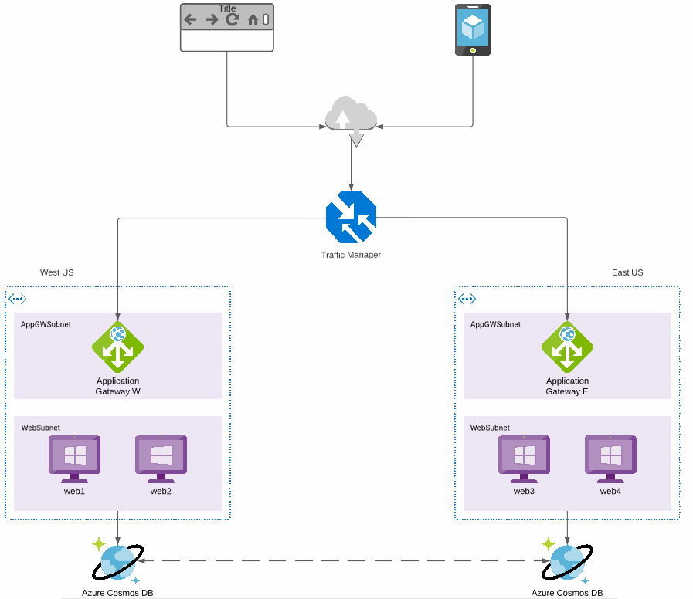
Reference Topology

Slide 80
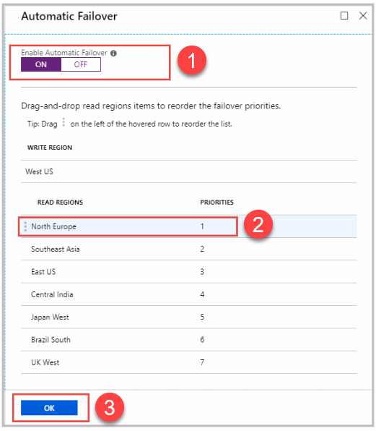
Cosmos DB Automatic Failover
Task: Protecting your Cosmos DB account against a Microsoft-side regional outage
Service-managed failover is not enabled by default
Account-level failover priority

Slide 81
Manual Failover with Azure CLI
# Ref: timw.info/799
# Set account to manual failover first
az cosmosdb update --name $account --resource-group $resourceGroup --locations regionName="$location" failoverPriority=0 isZoneRedundant=False --locations regionName="$failoverLocation1" failoverPriority=1 isZoneRedundant=False --locations regionName="$failoverLocation2" failoverPriority=2 isZoneRedundant=False
# Make failoverLocation2 the next region to fail over to instead of failoverLocation1
echo "Switching failover priority"
az cosmosdb failover-priority-change --name $account --resource-group $resourceGroup --failover-policies "$location=0" "$failoverLocation1=2" "$failoverLocation2=1"
# Initiate a manual failover and promote failoverLocation1 as primary write region
echo "Failing over to $failoverLocation1"
az cosmosdb failover-priority-change --name $account --resource-group $resourceGroup --failover-policies "$location=2" "$failoverLocation1=0" "$failoverLocation2=1"

Slide 82
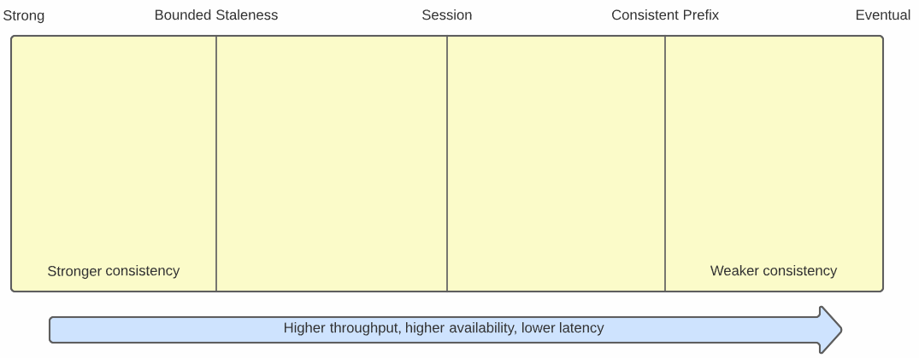
Cosmos DB Consistency Levels

Slide 83
Overriding Default Consistency
ItemRequestOptions options = new() {
ConsistencyLevel = ConsistencyLevel.Eventual
};
string id = "706cd7c6-db8b-41f9-aea2-0e0c7e8eb009";
string categoryId = "9603ca6c-9e28-4a02-9194-51cdb7fea816";
PartitionKey partitionKey = new (categoryId);
Product item = await container.ReadItemAsync<Product>(id, partitionKey,
requestOptions: options);

Slide 84
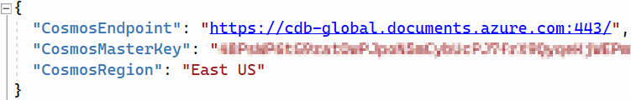
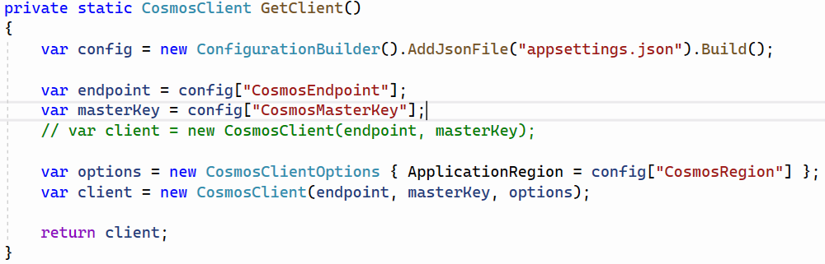
Cosmos SDK Configuration

Slide 85
Client-Side Configuration
CosmosClientOptions options = new CosmosClientOptions();
options.ApplicationName = "MyApp";
options.ApplicationPreferredRegions = new List<string> {Regions.WestUS, Regions.WestUS2};
CosmosClient client = new CosmosClient(connectionString, options);

Slide 86
Enable Multi-Region Writes (PS)
$resourceGroupName = "myResourceGroup"
$accountName = "mycosmosaccount"
$enableAutomaticFailover = $false
$enableMultiMaster = $true
# cannot have both service-managed failover and multi-region writes on an account
Update-AzCosmosDBAccount `
-ResourceGroupName $resourceGroupName `
-Name $accountName `
-EnableAutomaticFailover:$enableAutomaticFailover
# Now enable multi-region writes
Update-AzCosmosDBAccount `
-ResourceGroupName $resourceGroupName `
-Name $accountName `
-EnableMultipleWriteLocations:$enableMultiMaster

Slide 87
Conflicts and Multi-Region Writes
Cosmos DB has built-in conflict management
Conflict types:
Delete: Client updates item deleted in another region
Insert: Simultaneous inserts with same unique ID
Replace: Concurrent updates from different regions
Default conflict resolution policy is Last Write Wins
Item with largest _ts value "wins" conflict
Can override with custom conflict resolution policy

Slide 88
Custom Conflict Resolution Policy
Set policy on container
Can be defined only at container creation
Default conflict resolver is _ts property
Register a JavaScript merge stored procedure
If empty, conflict goes to conflict feed
Alternative approach: Handle conflicts directly with the conflict feed

Slide 89
Read from Conflict Feed (SDK v3)
FeedIterator<ConflictProperties> conflictFeed = container.Conflicts.GetConflictQueryIterator();
while (conflictFeed.HasMoreResults)
{
FeedResponse<ConflictProperties> conflicts = await conflictFeed.ReadNextAsync();
foreach (ConflictProperties conflict in conflicts)
{
// Read the conflicted content
MyClass intendedChanges = container.Conflicts.ReadConflictContent<MyClass>(conflict);
MyClass currentState = await container.Conflicts.ReadCurrentAsync<MyClass>(conflict, new PartitionKey(intendedChanges.MyPartitionKey));
// Do manual merge among documents
await container.ReplaceItemAsync<MyClass>(intendedChanges, intendedChanges.Id, new PartitionKey(intendedChanges.MyPartitionKey));
// Delete the conflict
await container.Conflicts.DeleteAsync(conflict, new PartitionKey(intendedChanges.MyPartitionKey));
}
}

Slide 90
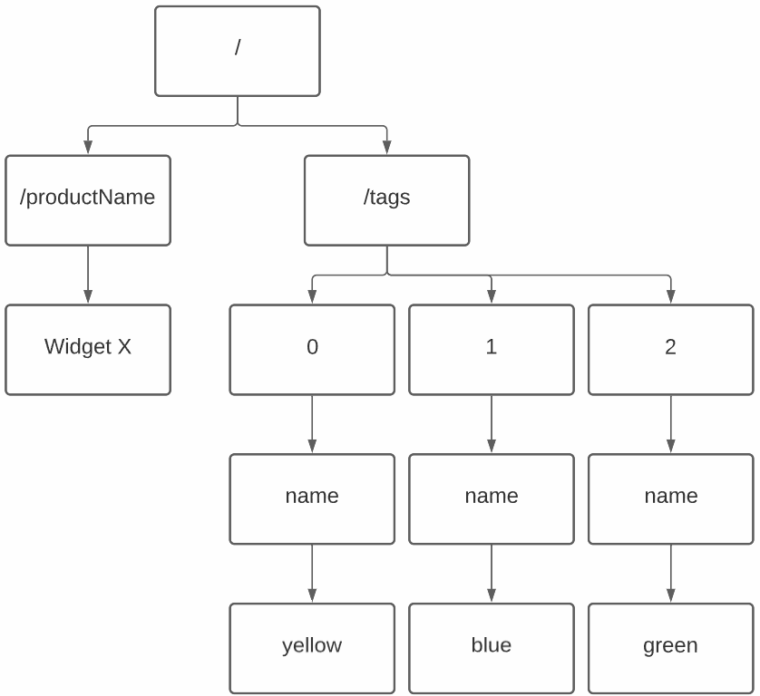
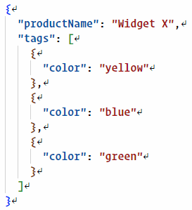
Cosmos DB Default Indexing

Slide 91
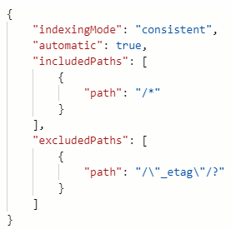
Cosmos DB Custom Policy
consistent = enabled
none = disabled
Index on write
Examples:
/name/? = scalar property
/category/* = all properties
/tags/[]/name/? = scalar within array
Can be combined with includedPaths for more precision

Slide 92
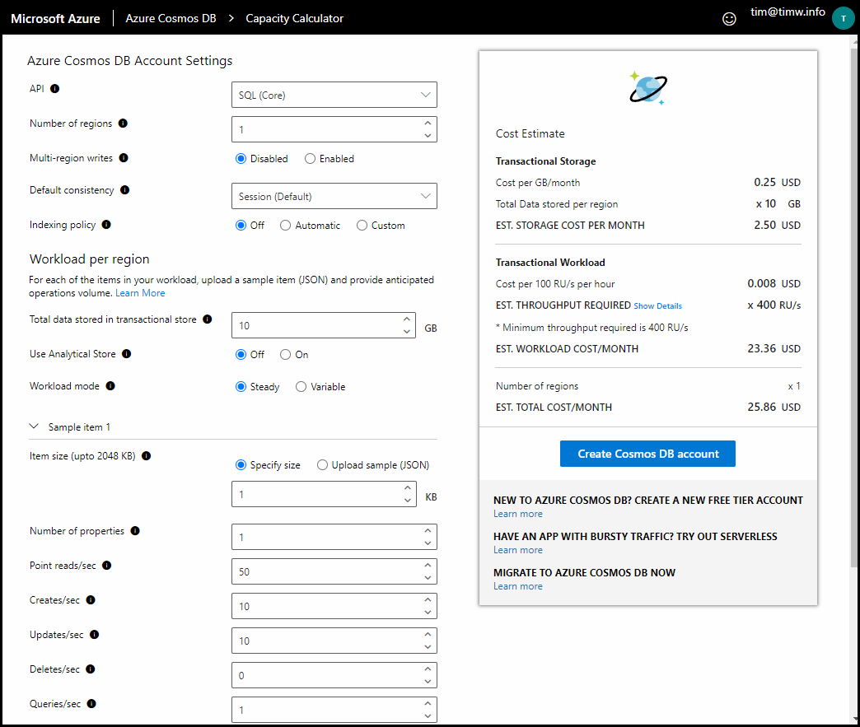
Cosmos DB Capacity Calculator

Slide 93
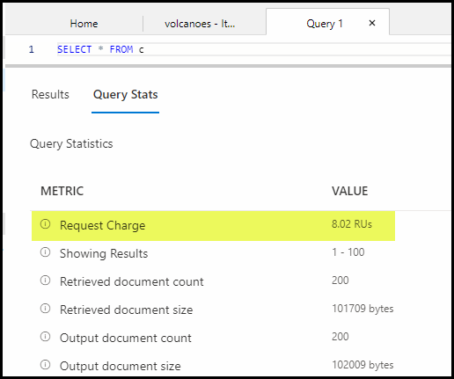
Find RU Charge for an Operation
// use SDK
string queryText = "SELECT * FROM c";
requestCharge = sprocResponse.RequestCharge;
FeedIterator<dynamic> feedIterator = container.GetItemQueryIterator<dynamic>(
queryText: queryText,
requestOptions: new QueryRequestOptions() { PartitionKey = new PartitionKey(partitionKey) });
while (feedIterator.HasMoreResults)
{
FeedResponse<dynamic> feedResponse = await feedIterator.ReadNextAsync();
requestCharge = feedResponse.RequestCharge;
}

Slide 94
Data Distribution

Slide 96
Cosmos DB Integration

Slide 97
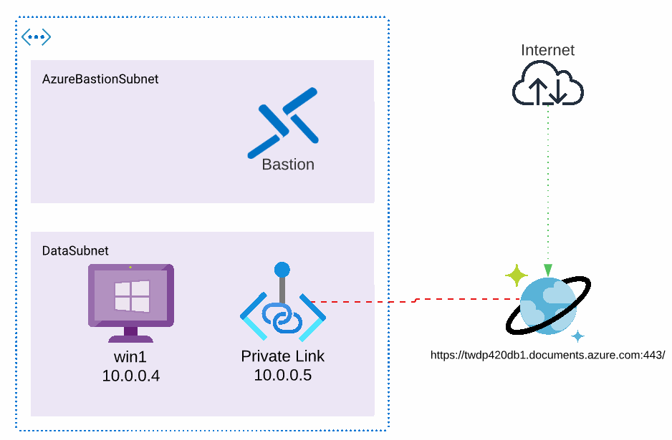
Private Endpoints

Slide 98
Azure Synapse Analytics
Enterprise data analytics service
Synapse SQL
Relational data warehousing
Apache Spark for Azure Synapse
Non-relational big data analytics
Integration
Azure Data Lake, Cosmos DB, Azure ML, Power BI, Azure Data Factory
Azure Synapse Studio unified web portal

Slide 99
Cosmos DB Connector for Spark
Open source project at GitHub
Read and write from Cosmos DB via Apache Spark DataFrames in Python or Scala
Azure Spark solutions:
Azure HDInsight
Azure Databricks
Apache Spark for Azure Synapse

Slide 100
Azure Synapse Link for Cosmos DB
Supports cloud-native hybrid transactional and analytical processing (HTAP)
Business case: "How can we use Cosmos DB in our data analytics without disturbing our production workload?"
Extract-Transform-Load (ETL) without need for large-scale data movement
Synapse Spark supports Scala, Python, Spark SQL, and C#

Slide 101
Cosmos DB Stores
Transactional store: Container-level, row-based data store for fast transactional reads and writes
Analytical store: Container-level, column-oriented data store
Cosmos auto-syncs changes to transactional store to analytical store

Slide 102
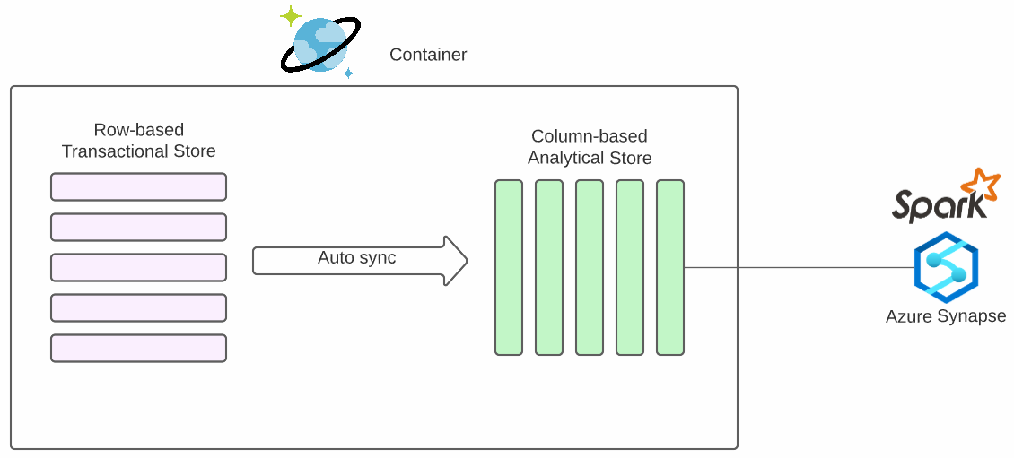
Cosmos DB Data Stores

Slide 103
Preliminary Definitions
Azure Functions: Serverless solution that supports a microservices architecture
Event (trigger)-based execution
Language support: C#, Java, JavaScript, PowerShell, Python, TypeScript, Go
Azure Event Hub: Fully managed, real-time data ingestion service
Handles millions of events per second
Related Azure service: Stream Analytics

Slide 104
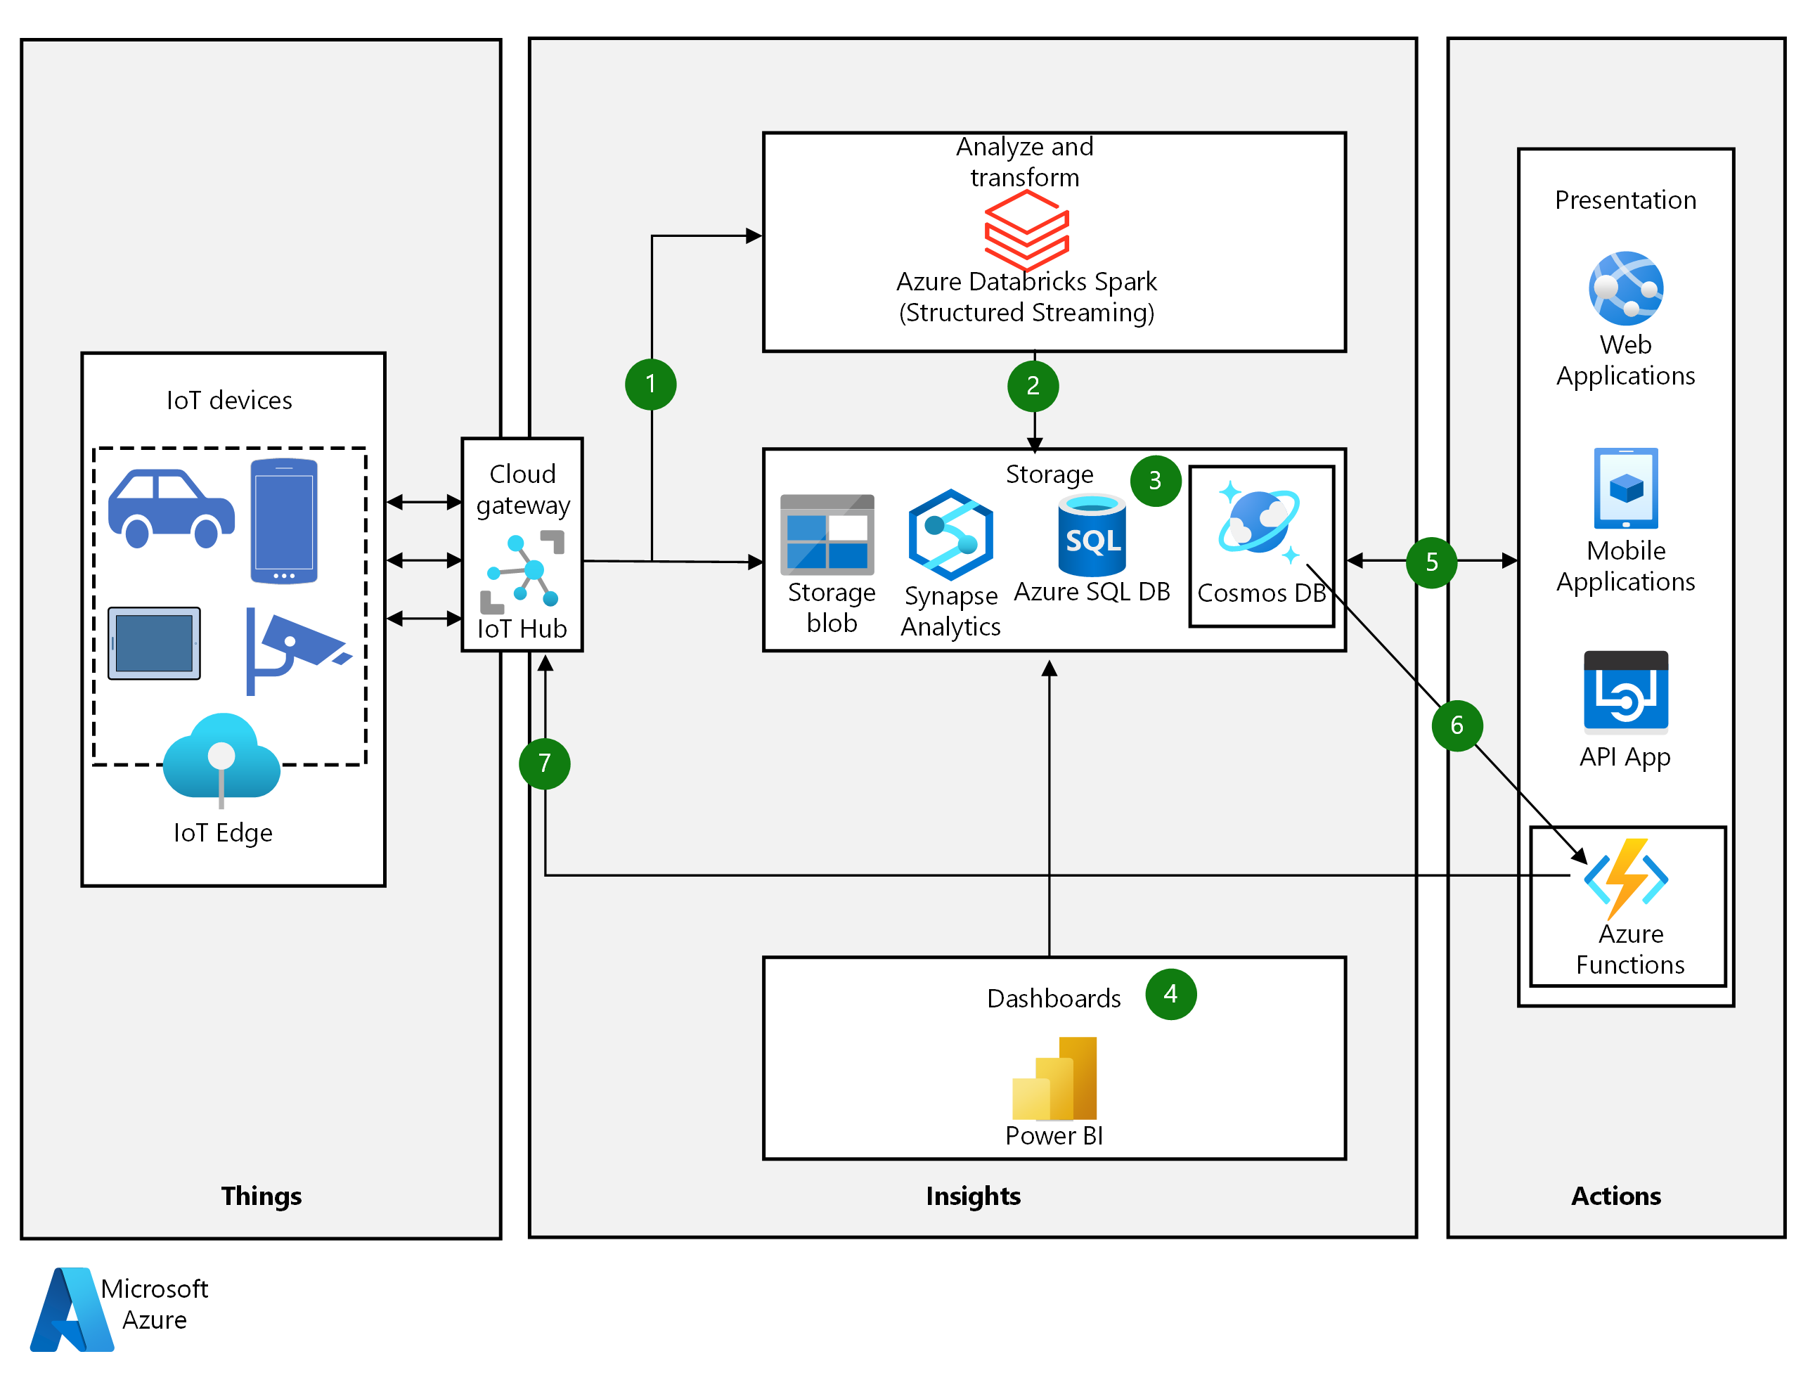
Reference Architecture: IoT
timw.info/thu

Slide 105
The Case for Denormalization
With NoSQL databases, there are no joins between containers
Optimize query requests by packing as much useful data into each document within a container & logical partition
But what if:
An element name changes in one container
There's no relational referential integrity!

Slide 106
Cosmos DB Change Feed
Use cases
Data denormalization
Replication between containers
Triggered notifications
Materialized views
Access with the Change Feed Processor (CFP) library in the Cosmos DB .NET v3 SDK

Slide 107
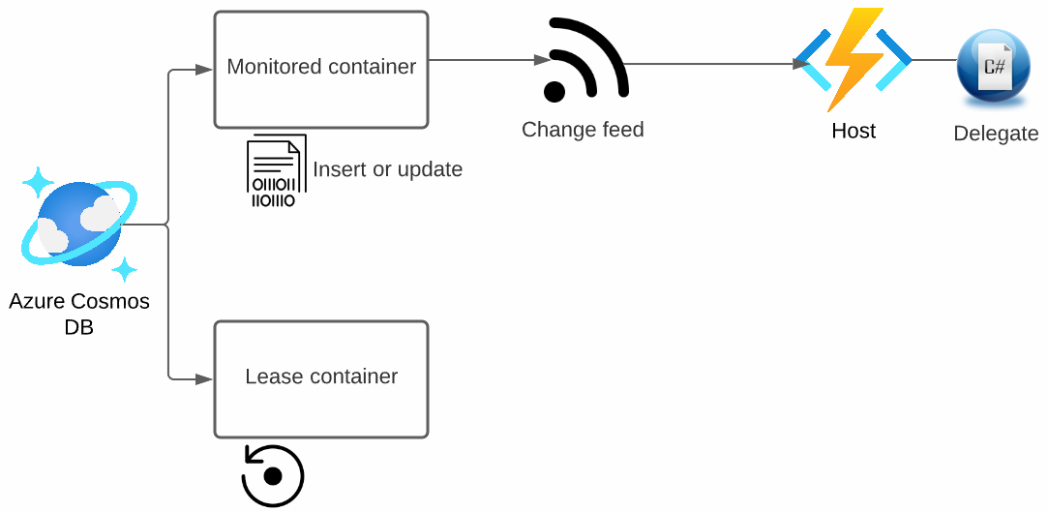
Change Feed Procesor Components

Slide 108
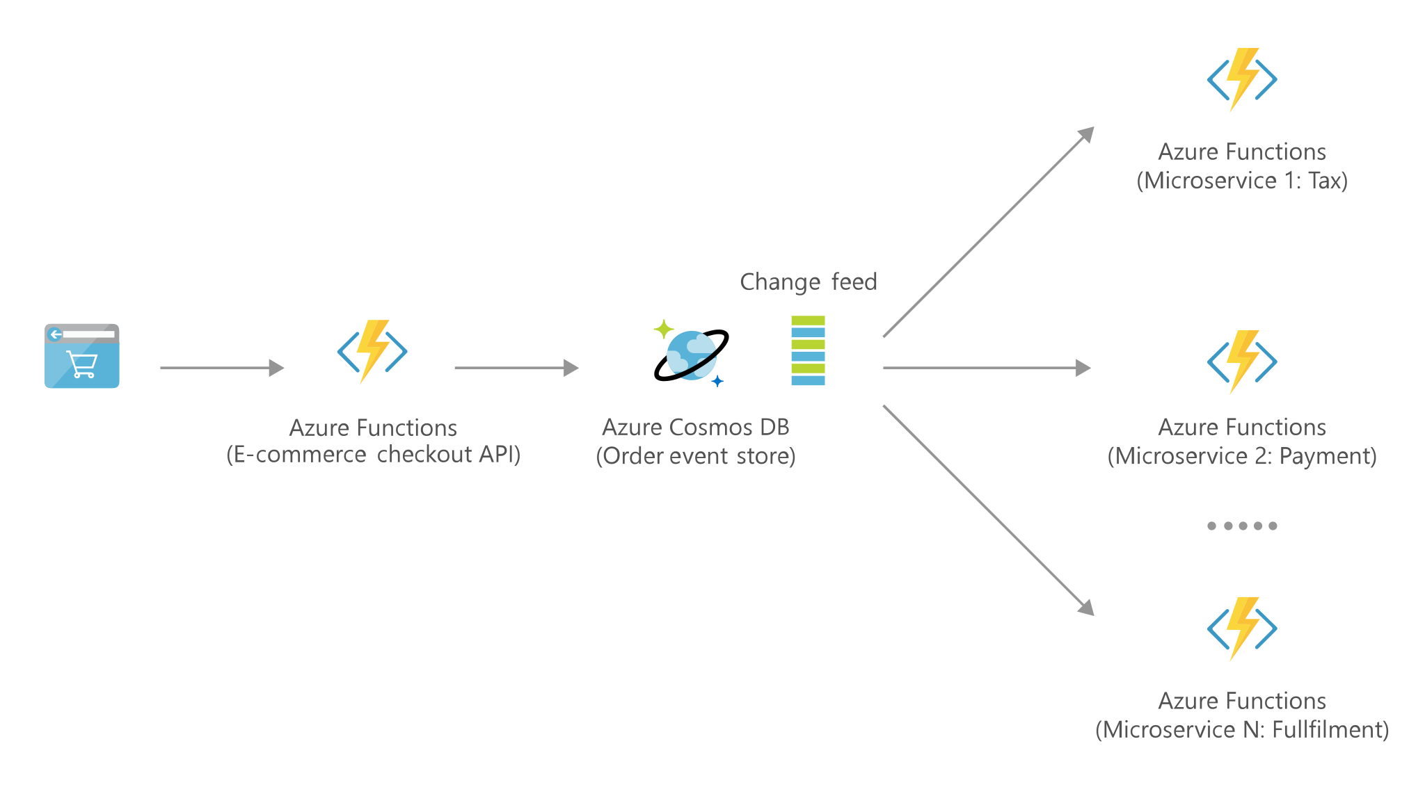
Reference Architecture: Retail
timw.info/q5x

Slide 109
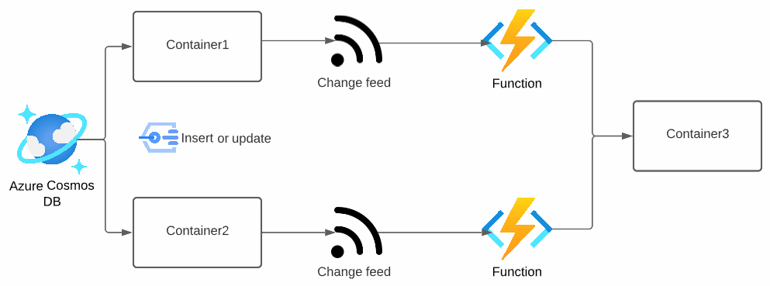
Change Feed Processing

Slide 110

Azure Cognitive Search Indexer
timw.info/7md

Slide 111
Cosmos DB Monitoring and Optimization

Slide 113
Diagnostic Log Categories
Category | Definition
CassandraRequests | Logs requests to Azure Cosmos DB API for Cassandra (Disable DataPlaneRequests)
ControlPlaneRequests | Logs account creation, region selection, replication, etc.
DataPlaneRequests | Logs CRUD operations within Cosmos DB account
GremlinRequests | Logs requests to Azure Cosmos DB API for Gremlin

Slide 114
Diagnostic Log Categories
Category | Definition
MongoRequests | Logs requests to Azure Cosmos DB API for MongoDB
PartitionKeyRUConsumption | Logs per-second RU consumption of partition keys
PartitionKeyStatistics | Logs storage size of partition keys
QueryRuntimeStatistics | Query operations against SQL API (query text and parameters are obfuscated, but can be overridden)
TableApiRequests | Requests to Azure Cosmos DB API for Table Service

